Slide 1

DR.Lankapalli Bullayya Degree & PG College Team Leader (Dunga Chandra Praveen) duvvi jayanth Lolla kalli Margana Naresh

Slide 2
Index
Part-1 : Brand study, Competitor Analysis & Buter’s/Audience’s Persona.
Part -2 : SEO & Keywords Research.
Part-3 : Content Ideas and Marketing Strategies.
Part -4 : Content Creation And Curation (post creations , Desings/Video Editing, Ad Campaigns
over Media and Email Ideation and Creation)

Slide 3
Part 1 : Brand Study ,Competitor Analysis
&Buyer’s/Audience’s persona
RESEARCH BRAND
: Mahindra & Mahindra started a joint venture with British Telecom in 1986 as a technology
outsourcing firm . At that point in time the company was named Mahindra British Telecom (MBT). Later it was
renamed as Tech Mahindra .
MISSION VALVES
: Tech Mahindra’s mission valves often focus on innovation , excellence integrity, customer –
centricity ,team work, and social responsibility. They strive to leverage technology to drive positive change while maintaining high ethical standards and a commitment to customer satisfaction.
USP
: Tech Mahindra’s unique spelling proposition (USP) lies in its expertise in digital transformation , innovation ,
and industry-specific solutions. They emphasize their ability to combine cutting-edge technology with deep
industry knowledge.
ANALYZE BRAND TONE AND IDENTITY
: Tech Mahindra identity is deeply rooted in its commitment to driving
digital transformation and innovation while up holding core valves such as integrity , diversity, and sustainability.
SMART GOALS AND KPIS FOR TECH MAHINDRA
: Smart goals ( specific, measurable, achievable, relevant , time
bound ) and corresponding key performance .

Slide 4
Brand study (mission/values & USP)
MISSION & VALUES:
Tech Mahindra missions and values typically revolve around innovation, integrity, and excellence in service delivery. they often prioritize
leveraging technology to solve complex business.
KIND: IT SERVICES
: providing a wide range of information technology services such as applications development, infrastructure
management, cloud services , cyber security ,and digital transformation.
EFFECTIVE
: Tech Mahindra consistently innovates to provide cutting-edges solutions to its clients. Tech Mahindra focuses on
understanding clients needs and delivering solutions that exceed expectations.
UNIQUE SELLING PROPOSITION ANALYSIS
: Tech Mahindra specializes in helping business navigate digital transformation
journeys , leveraging emerging technology like AI , LOT , block chain and cloud computing to drive innovation and growth.

Slide 5
Brand study ( Brand Tone & KPI)
global economic conditions, industry trends, and company strategic initiatives.
CUSTOMER SATISFACTION: Tech Mahindra places a high priority on customer satisfaction by consistently delivering quality services and solutions tailored to meet their clients needs.
BRAND AWARENESS: Tech Mahindra has establish a strong awareness globally as a leading provider of digital transformation and IT services. Tech Mahindra brand visibility is bolstered by their extensive client portfolio, partner ships with industry leaders , partnership with industry leaders major Technology events and conferences, and active presence on social media.
MARKET SHARE: Tech Mahindra is a significant player in global IT services market , but its exact market share can vary depending on the specific segment or region . As of my last update. Tech Mahindra typically competes with other major IT services .
TONE
: The brand tone of Tech Mahindra is typically professional , innovation, and customer- centric. They aim to communicate expert
BRAND is and reliability while also show casing their forward thinking approach to technology solutions.
SALES GROWTH
: Tech Mahindra sales growth can be influenced by various factors, including market demand for technology services,

Slide 6
Buyer/Audience persona
Goals:G typically revolve around driving growth , innovation , and value creation for its clients , employees, and stakeholders . Some of its key goals may include :
Name: Praveen
Demographics:
Age: 18-35
1 . Customer Satisfaction : Tech Mahindra aims to exceed customer expectations by delivering high-quality solutions and services that address their evolving needs .
Gender: All gender
Occupation:
Income: middle to high-income individuals
2. Innovation and Technology : Leadership : Tech Mahindra strives to be at the forefront of technological innovation , continuously developing new solutions and leveraging technologies to drive digital transformation or its clients .
Psychographics:
Values: Tech Mahindra ,a leading IT services and consulting company ,emphasizes values such as integrity
, customer focus , innovations , agility ,teamwork , and social responsibility .
Challenges : Some of the challenges that Tech Mahindra , like any other technology company ,may face . Marketing Competition of Tech Mahindra operates in a highly competitive industry where It
Interests : Interest in Tech Mahindra often stems form its prominent position in the IT industry , its diverse range of services spanning from IT consulting to business .
Personality: Tech Mahindra is often characterized by a dynamic and innovative personality , reflecting its competes with both established players and emerging startups.
roots in the technology sector and its commitment to driving digital transformation for its clients .
Staying ahead of competitors and maintaining market share can be
significant challenge .
Behaviour: Overall , Tech Mahindra strives to maintain a positive and proactive approach all its interactions , embodying the values of trust , reliability , and excellence .
Social media usage: Tech Mahindra utilizes social media platforms such as Twitter , LinkedIn , Facebook , and Instagram to engage with its audience , share company updates , showcase its latest project in industry conversations.

Slide 7
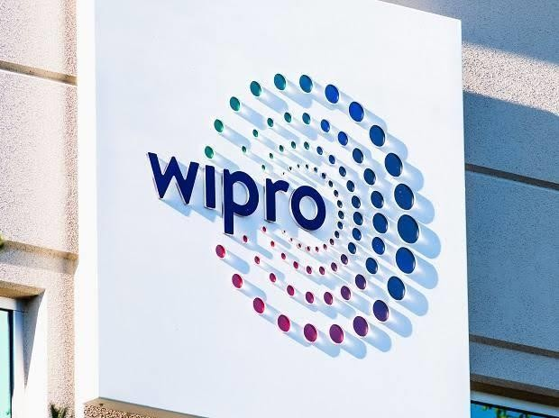

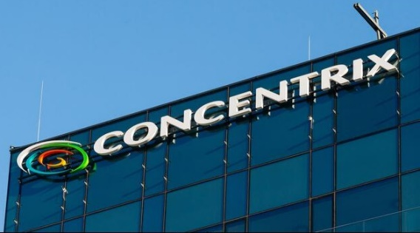
Part 1 : Band study , Competitor Analysis &
Buyer’s /Audience’s persona
Competitor Analysis : Comparing Tech Mahindra with WIPRO,PATRA and CONCENTRIX involves looking at various
aspects such as industry focus , service offering performance , and geographic presence . Here’s a brief competitor analysis.
WIPRO : Wipro Limited is a global information technology , consulting , and business process services company headquartered in Bangalore ,India. Here’s a brief overview of Wipro
Patra Corp: Patra Corp is a company specializing in insurance processing and technology solutions. They offer services such as policy checking, data entry, customer service, and software development for insurance agencies and carriers.
Concentrix: Concentrix is a global business services company specializing in customer engagement and business performance optimization.

Slide 8
Competitor 1 : Wipro
USP : Overall , Wipro’s lies in its technological expertise ,global delivery capabilities , industry-specific solutions, client-centric approach ,and commitments to innovation , enabling it to clients in a competitive market landscape.
Online Communication :
Overall , Wipro’s online communication strategy is focused in building brand awareness ,thought leadership , and engagement with its audience through a combination of corporate website, social media , thought leadership content , virtual events, and email newsletters.
These channels enable Wipro to effectively communicate its messages , connect with stakeholders ,and drive business out comes in the digital age.

Slide 9
Swot
Strength :
Wipro possesses several strength that contribute to its position as a leading global IT services company .
This deep technology knowledge enables Wipro to develop innovative solutions and drive transformation for its clients .
These strengths position Wipro as a trusted for organizations seeking to leverage technology to drive business
growth and success.
Weakness :Wipro, like any company, has its strengths and weaknesses. Some commonly cited weaknesses of Wipro
Wipro’s heavy reliance on IT services, particularly outsourcing, can be seen as a weakness in a rapidly evolving
market where companies are increasingly looking for more specialized beyond traditional IT services.
Like many IT services companies, Wipro faces challenges in attracting , retaining, and developing top talent, particularly in where competition for skilled professionals is intense

Slide 10
Swot
Opportunities : Wipro has opportunities for growth and expansion in the rapidly evolving technology landscape.
The increasing demand of digital transformation services presents a significant opportunity of Wipro .
Wipro has the opportunity to lead in emerging technologies such as blockchain , 5G, edge computing , and augmented
reality/virtual reality (AR/VR).
Overall, Wipro has numerous opportunities to drive growth, innovation ,and value creation by leveraging its technological expertise, industry focus, global presence, and strategic partnership in a rapidly evolving digital economy.
Threats : Wipro faces several threats that cloud impact its business operations and growth prospects.
Wipro operates in a highly competitive market with other global IT services companies, as well as emerging startups.
Intense competition can lead to pricing pressure, loss of market share, and challenges in acquiring and retaining clients
.

Slide 11

Competitor 2: Patra
USP : Patra(Holding) Limited, as a global business process management (BPM) company ,offers several unique
selling propositions (UPSs) that differentiate it from its competitors.
Online Communication :
Overall ,Patra’s online communication strategy is focused on building brand awareness, thought leadership, and engagement with its audience through a combination of corporate website, social media, virtual events, and email newsletters. These channels enable WNS to effectively communicate its messages, connect with stakeholders ,and drive business outcomes in the digital age.

Slide 12
Swot
Strength : Patra (Holding) Limited, as a global business process management (BPM) company, several strengths that contribute to its success in the industry.
possesses
This industry-specific knowledge allows Patra to understand the unique challenges and requirements of each sector and deliver tailored solutions that drive business outcomes for its clients.
Patra leverages a global delivery model with delivery centers and offices in multiple countries across continents.
Weakness: While Patra(Holdings) Limited has numerous strengths, its also faces some weakness and challenges that could impact its business operations and growth prospects .
Patra relies heavily on outsourcing for its business model.
This dependency on third-party vendors and subcontractors can sometimes lead to concerns about quality control, communication barriers and potential risks associated with outsourcing sensitive or critical business functions

Slide 13
Swot
Opportunities : Patra (Corporation India) offers various opportunities across industries like
business process management, outsourcing, analytics, and consulting .
Some potential opportunities could include career advancement, skill development, global exposure, and the chance to work with diverse clients and projects .
Additionally, Patra often provides training programs and career growth paths for employees.
Threats: potential threats to Patra could include competition from other outsourcing firms, economic downturns affecting client budgets, changes in government regulations impacting outsourcing practices, and advancements in technology leading to automation of certain services.
Additionally, geopolitical instability in regions where Patra operates could pose risks to its operations
.

Slide 14

Competitor 3 : Concentrix
USP : Concentrix offers a comprehensive suite of services to help businesses improve their customer interactions and operational efficiency. This includes providing customer support through various channels such as phone, email, chat, and social media, as well as implementing technology solutions to enhance customer experience and streamline business processes.
Online Communication: Concentrix employs various online communication channels to engage with customer and stakeholders. This includes an official website featuring product information, new updates, and customer support. They likely utilize social media platforms such as Facebook, Twitter, Instagram and LinkedIn for branding ,promotions, and customer interaction . Additionally, Concentrix may leverage email newsletters, online advertising ,and video content to reach their audience effectively.

Slide 15
Swot
Strength : Concentrix has several strengths that contribute to its position as a leading global business services company in the customer engagement and business performance optimization industry.
Additionally, its strong brand presence, especially in emerging markets like India, contributes to its market leadership.
Concentrix operates in over 40 countries, allowing it to provide services to clients around the world.
Concentrix places a strong emphasis on understanding its clients' businesses, goals, and customers' needs. By adopting a customer-centric approach, Concentrix aims to build long-term partnerships with its clients.
Weakness : Some weakness of Concentrix may include:
Concentrix's business model relies heavily on maintaining strong client relationships and contracts. If it were to lose key clients or fail to renew contracts, it could impact its revenue and growth prospects.
Like any service-oriented company, Concentrix's reputation is critical to its success. Negative publicity, customer complaints, or service quality issues could damage its brand and impact its ability to attract and retain clients.

Slide 16
Swot
Opportunities : Concentrix has several opportunities to explore.
With the increasing demand for digital solutions and automation across industries, Concentrix can capitalize on opportunities to offer digital transformation services to its clients.
Concentrix can develop specialized industry solutions tailored to the unique needs of specific sectors such as healthcare, retail, financial services, and telecommunications.
Threats : Concentrix faces several threats that could impact its operations and growth prospects.
If Concentrix relies too heavily on a small number of large clients for a significant portion of its revenue, it could be vulnerable to financial instability if one of those clients reduces its business or terminates its contract.
As a provider of digital services and solutions, Concentrix is exposed to cybersecurity threats such as data breaches, malware attacks, and phishing scams.

Slide 17
Part 2 : Seo & Keyword Research
Seo Audit : DO an SEO audit of the Tech Mahindra brand website
Keyword Research : Keyword research for a company like Tech Mahindra would typically involve identifying relevant terms related to their services, products, and industry. Here are some potential keywords : Tech Mahindra services, IT solutions Tech Mahindra, Tech Mahindra digital transformation, Tech cloud services, and etc. These keywords can help in understanding what people are searching for related to Tech Mahindra and guide content creation and optimization strategies.
On page Optimization: Optimizing Tech Mahindra’s online pages involves various strategies to enhance their
visibility, relevance, and user experience. Here are some key optimization tips.
Keyword Optimization, Quality Content, Mobile Optimization, Pages Speed and Internal Linking . By implementing these optimization strategies, Tech Mahindra can improve its online presence, attract more organic traffic, and effectively engage with its target audience.

Slide 18
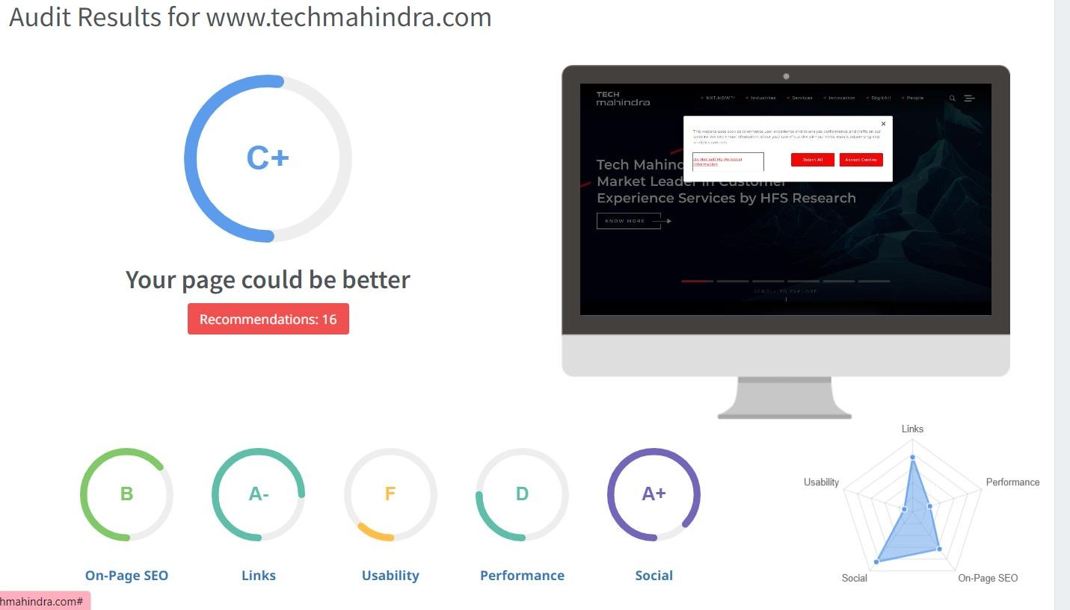
SEO Audit
The website has a fair SEO score however it can be improved in certain aspects such as link building & Usability.

Slide 19
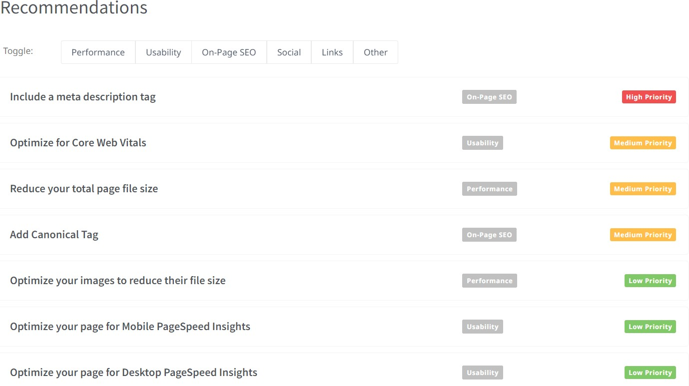
SEO Audit
Performing an SEO audit for Tech Mahindra involves assessing various aspects of its online presence to identify areas for optimization and improvement ,Here are some key areas to consider.

Slide 20
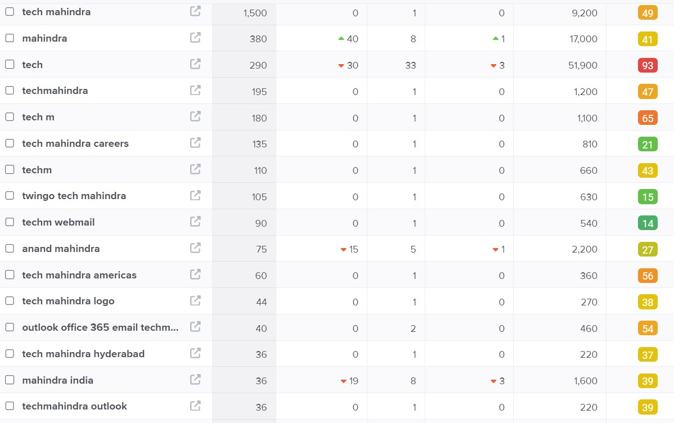
Keyword Research
Keyword Objective : Sale oriented
IT consulting services
Digital transformation
Tech Mahindra careers
Cybersecurity solutions.
We can use these 4 as primary keywords since they have decent volumes and are relevant to brand of Tech Mahindra.

Slide 21
On page Optimization
Focus Keywords: Tech Mahindra solutions, IT services Tech Mahindra Digital transformation Tech Mahindra
….etc.
Meta Title :
“All well-optimized meta title for Tech Mahindra’s website homepage could be . Tech Mahindra Leading IT solution & Digital Transformation Services provider.”
Meta Description :
Tech Mahindra is a leading global technology solutions provider offering consulting, digital transformation, and IT services to enterprises across various industries.

Slide 22
On page Optimization (Content optimization)
Introduction : Tech Mahindra is a multinational technology company headquartered in Indian, provide a wide range of services including IT consulting, digital transformation, and business process outsourcing. Founded in 1986 as a joint venture between Mahindra & Mahindra and British Telecommunications plc, Tech Mahindra has since grown into a key player in the global IT industry, serving clients in sectors such as telecommunications, manufacturing, healthcare, finance, and more. Tech Mahindra continues to drive digital transformation for businesses worldwide.
Section 1 : IT Services this division offers a comprehensive range of IT services, including application development, infrastructure management, cloud computing cybersecurity, and data analytics.
Section 2 : Tech Mahindra provides strategic consulting services to help businesses navigate digital transformation, optimize their operations, and achieve their business objectives.
Section 3 : With a focus on digital technologies such as artificial intelligence, Internet of things (IoT),blockchain, and automation, Tech Mahindra helps clients innovate and modernize their businesses for the digital age.
Section 4 : Being a significant player in the telecommunications industry, Tech Mahindra offers a range of services
tailored to telecom operators, including network design, implementation, and managed services.
Conclusion : In conclusion, Tech Mahindra stands as a prominent global technology solution provider, offering a comprehensive array of IT services, consulting, and digital transformation solutions. With a rich history dating back to its establishment in 1986, Tech Mahindra has evolving digital landscape.

Slide 23
Documents the challenges faced during the research and analysis phase , as well the key insight gained from the keyword research process
Getting a free tool to do keyword research is a task since most tools are paid
We understood how the users search & gained insights into the kind of keywords people search for.
Choosing the right keyword was an issue were a lot of relevant keyword in the list.

Slide 24
Part 3 : Content Ideas and Marketing Strategies
Content Ideas Generation & Strategy : Content ideas generation and strategy for Tech Mahindra could revolve around several key themes and approaches. Overall Tech Mahindra content strategy should aim to provide valuable insights demonstrate thought leadership and engage with its audiences in meaningful way , ultimately driving brand awareness , thought leadership , and business growth.
Mentioned in the calendar :

Slide 25
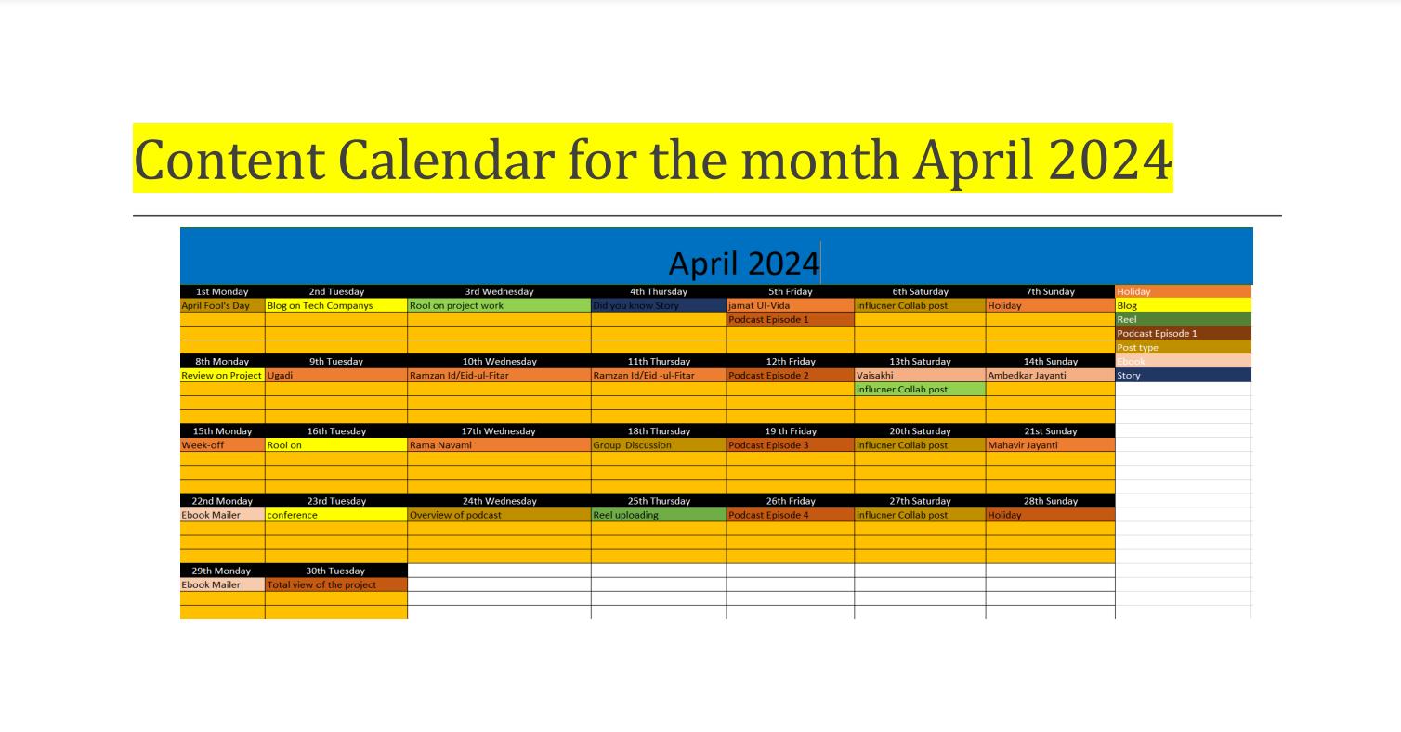

Slide 26
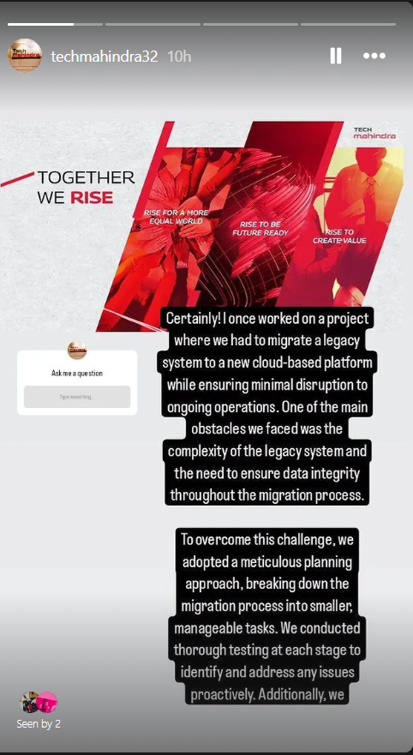
Strategy, Aim and the Idea behind this story
To apply for jobs at tech Mahindra, you can visit their website .They often list job openings and provide information on how to apply . You can also explore job portals like Linked in and Naukri for opportunities with Tech Mahindra.
Make sure to tailor your resume and cover letter to highlight relevant skills and experience for the positions you’re interested in . Good luck with your job search!

Slide 27
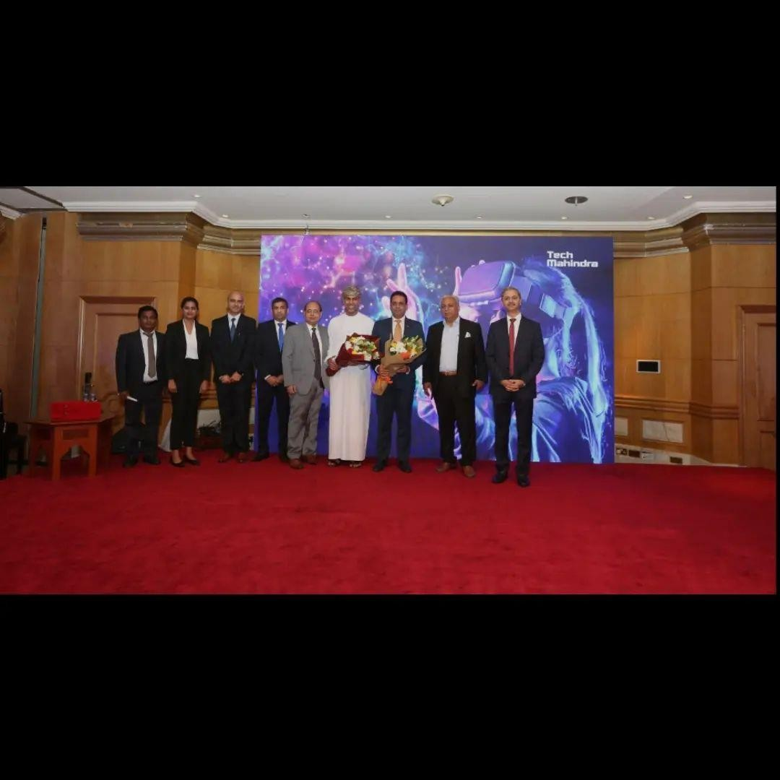
Strategy, Aim and the Idea behind this post
The strategy and aim of Tech Mahindra revolves around being a leading provider of digital transformation, consulting, and business re engineering services. The company focuses on leveraging emerging the technologies like AI, blockchain , and lo T to clients innovate and stay competitive in their industries . The core idea behind Tech Mahindra ids to enable business to adapt to the digital age effectively and efficiently. They emphasize collaboration, innovation, and agility to drives sustainable growth for their clients and themselves.

Slide 28
Part 3 : Content Ideas and Marketing Strategies
Tech Mahindra, a prominent IT services company, could explore content ideas and marketing strategies aligned with its expertise and target audience.
CONTENT IDEAS: *Thought leader ship articles publish articles on emerging technologies, industry trends, and best practices to establish thought leader ship in the tech sector.
case of studies : highlight successful client projects to show care Tech Mahindra capablities and expertise in delivering innovation solutions.
MARKETING STRATIGES :
Content marketing: distribute content various channel such as platforms, emails, news letters , and industry publications to reach a wider
audience.
Social media marketing: share valuable content , engage with followers, and participate on plat forms like LinkedIn , twitter, and face book.
Email marketing Campaigns: send targeted email campaigns to nurture leads promote content and drive conversions through to nurture leads , promote content, and drive conversions through personalized messaging

Slide 29
Part 4 : Content Creation and Curation Part
Post Creation :
Select Content Categories : content creation involves generation original content, such as articles, blog, posts, videos, infographics, and social media posts, to engage and inform your audience. It’s about producing valuable and relevant material that addresses the needs, interests, and pain points of your target audience. Here are some steps to consider when creating content.
Format 1
Format 2
Format 3

Slide 30
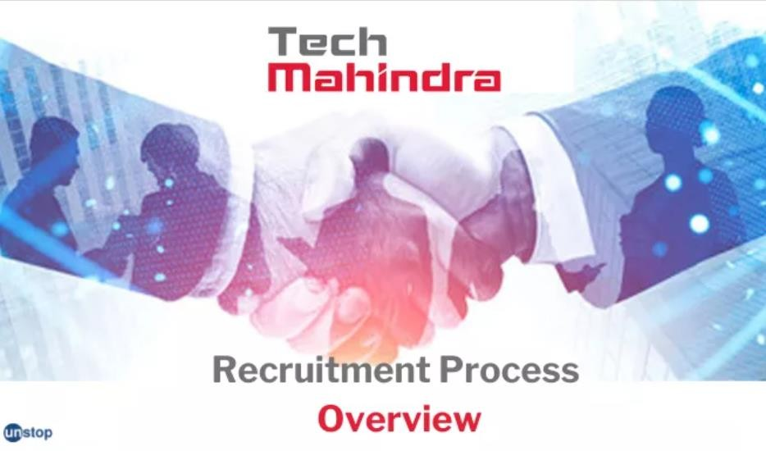
Format 1 : static post on Tech Mahindra
CAPTION : ‘Unlocking innovation, shaping the future. Proud to be a part of Tech Mahindra family!.
Link : https://www.Instagram.com/p/C6LCo_2SUk 3/?igsh=MTQwcnBjd3l1M3cxYg==
HASHTAGS: #Tech Mahindra# future ready#

Slide 31
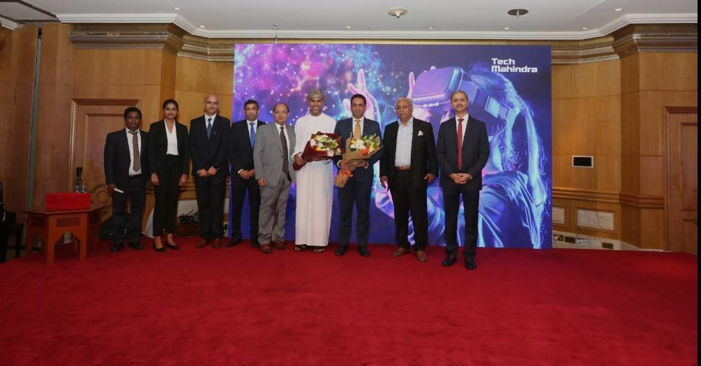
Format 2 :Reel Post
CAPTION : ‘ Unlocking the future ;Tech
Mahindra’s innovation reel’.
Higher opportunities.
Good placements.
*Industry experience.
*Digital transformation expertise. Link :
https://www.Instagram.com/p/C6LCo_2SUK3
/?gsh=MTQwcnBjd3l1M3cxYg==
HASHTAGS: #Tech Mahindra# future ready#

Slide 32
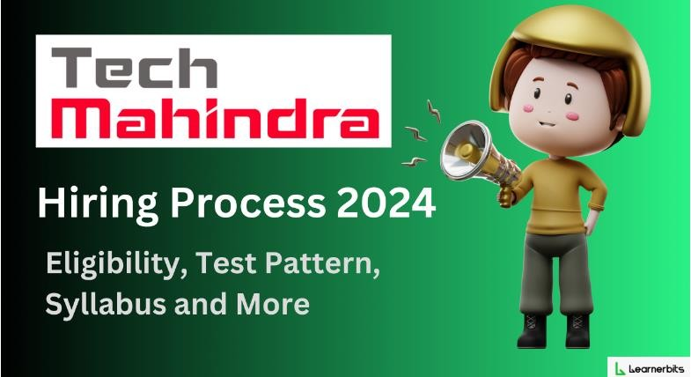
Format 3 : Carousel post
CAOTION: Brief overview of Tech Mahindra service and expertise. Highlight recent technological innovations .
* EMPLOYABILITY SKILLS
* SOCIAL RESPONSIBILITY
Link : https://www.Instagram.com/p/C6LBF8JSq6 u/?igsh=MWNpMXlrYm54Z3Nubw==
HASHTAGES : # Tech Mahindra# future ready#.

Slide 33
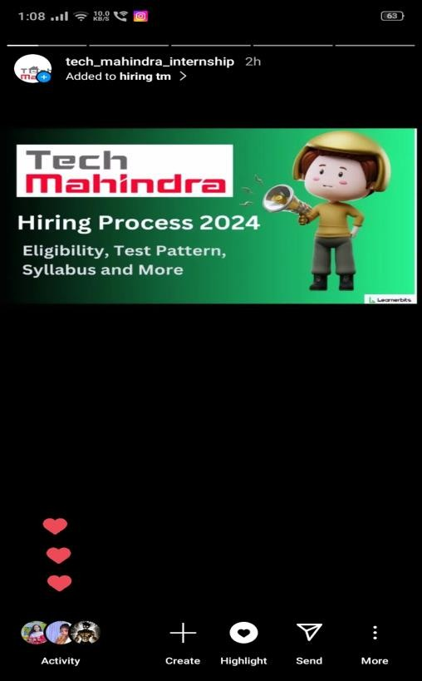
Screenshots of Story.
https://www.instagram.com/stories/tech_mahindra_internship

Slide 34
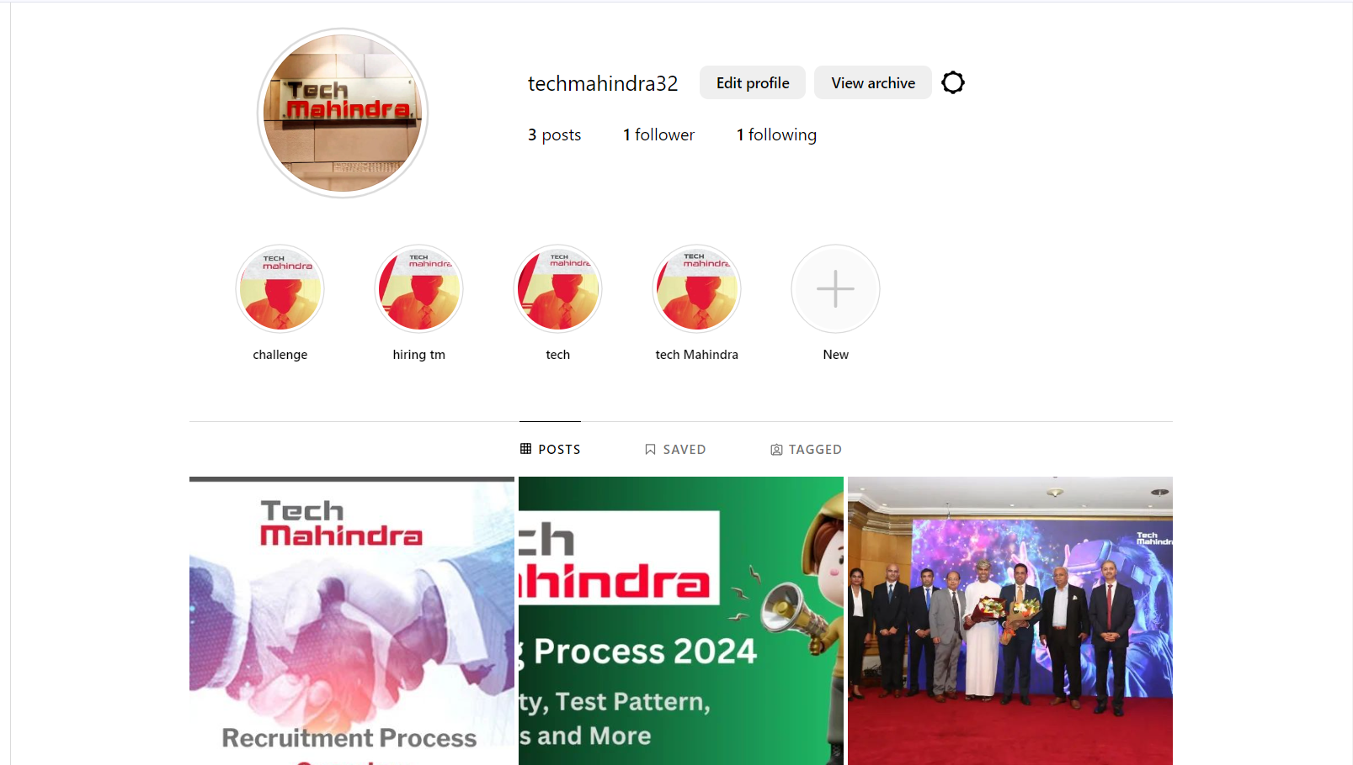
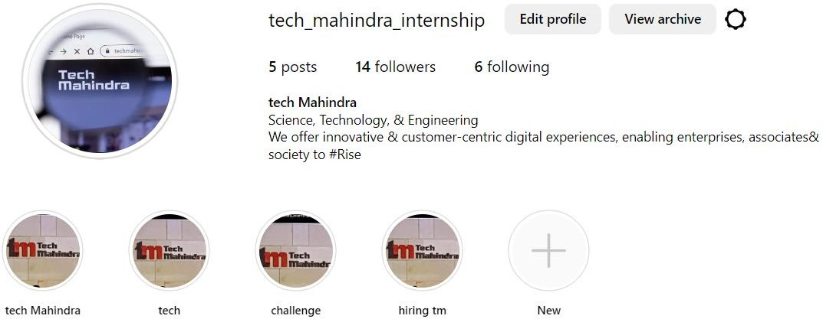
Highlights for Story.
https://www.instagram.com/tech_mahindra_internship/

Slide 35
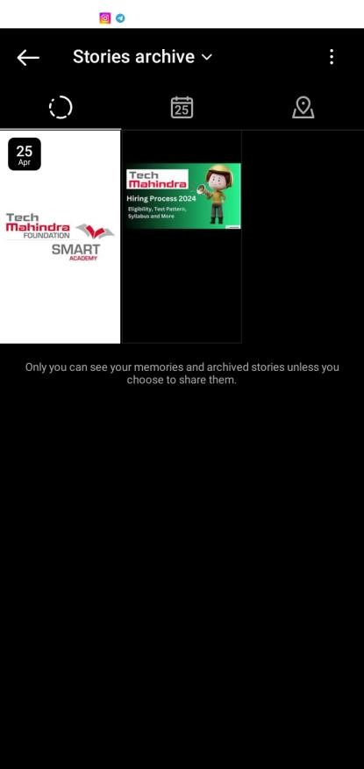
Story Insights-Q&A
Reach is 85
Impressions is 140
Likes is 25
Etc…
Areas for improvement : Story could be better. Quiz option would help in getting options.
Since the shares of informative stories are more, we could create more informative and stories

Slide 36
Part 4 : Content Creation and Editing
Designs/Video Editing
Design Tools Familiarization (use canva for creating visually appearing graphics)
Video Creation : Utilize VN video editor of your choice to create videos related to the chosen topic.

Slide 37
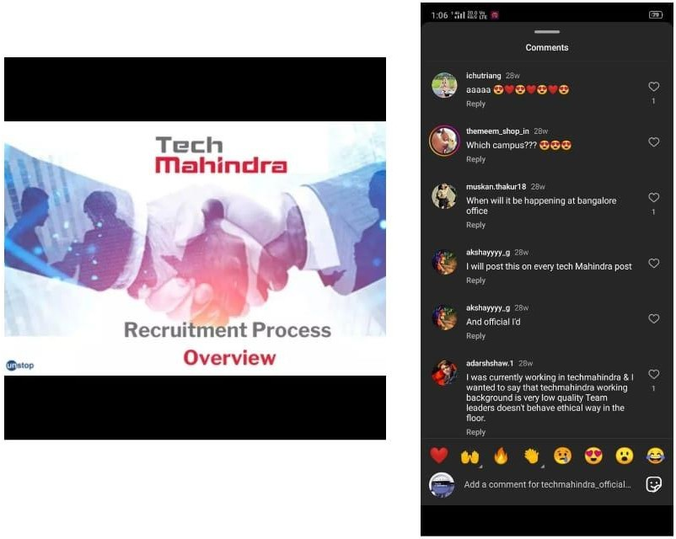
Instagram post
Caption : Tech Mahindra
Hastags : #tech#IT services# Link :
https://www.canva.com/design/DAGDfyQqGps/V
NAIlF7FhzVSHpWW_0gQ/view?utm_content=DAG fyQqGps&utm_campaign=designshare&utm_mediu m=link&utm_source=editor
_J
D

Slide 38
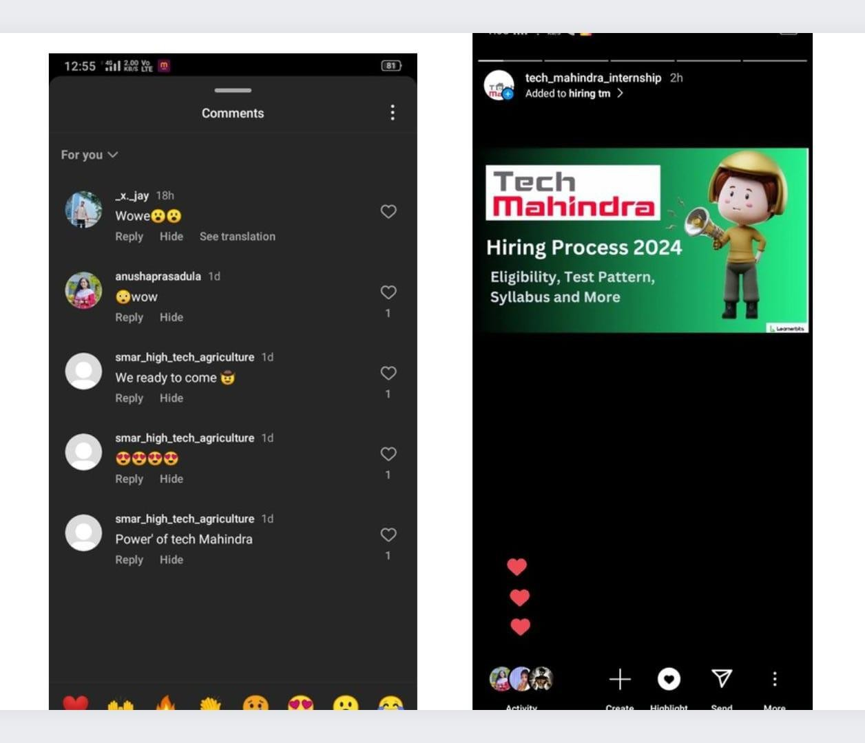
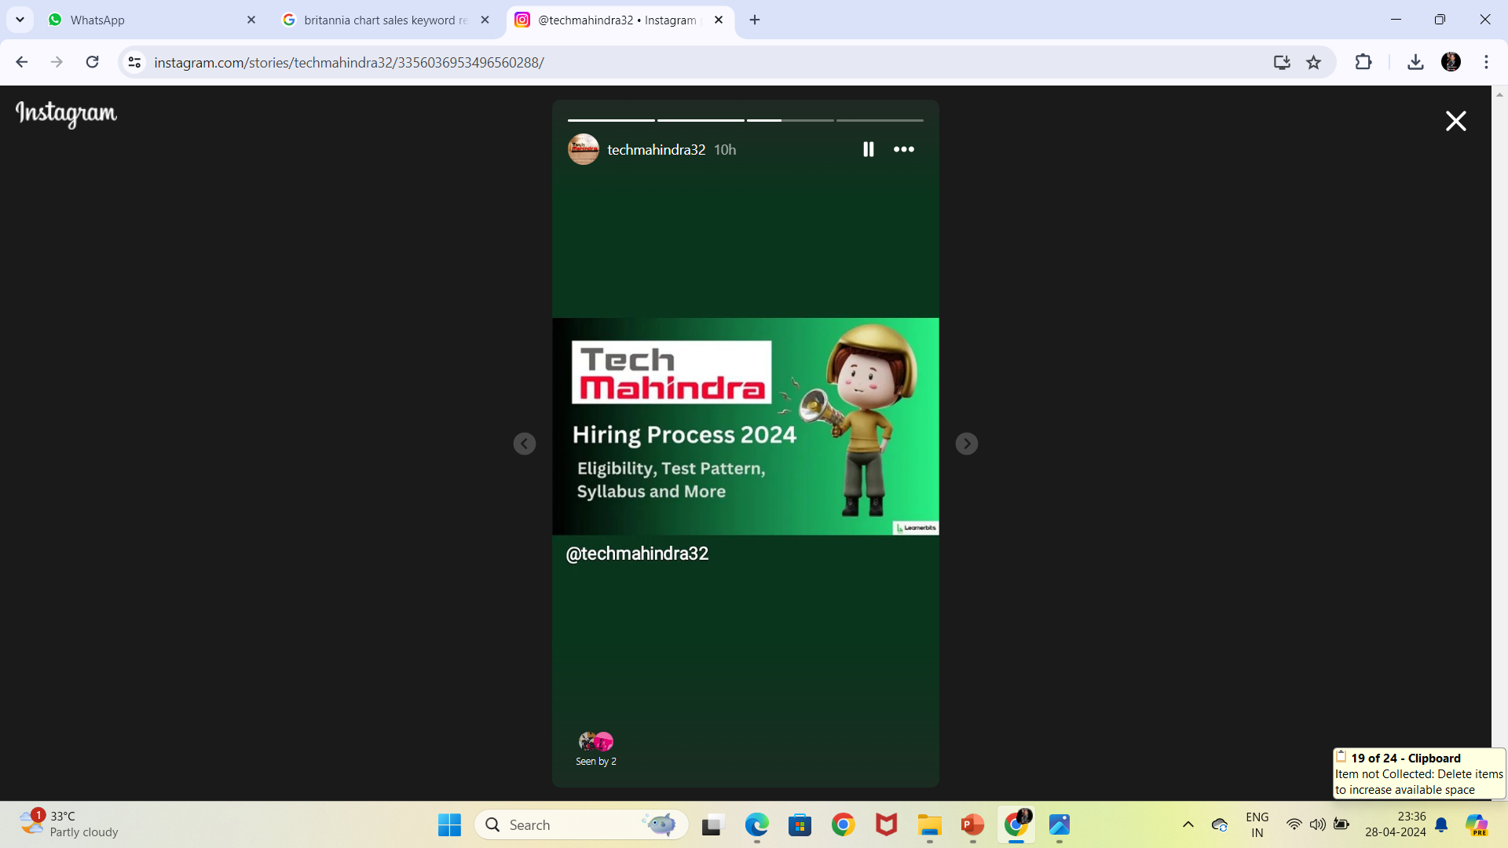
Instagram Story
Caption : Tech Mahindra Hiring process 2024.
Hastags : #techm#TechMahindra#hiringtech
Link : https://www.canva.com/design/DAGDfyQqGps/ V_JNAIlF7FhzVSHpWW_0gQ/view?utm_content
=DAGDfyQqGps&utm_campaign=designshare&u tm_medium=link&utm_source=editor

Slide 39
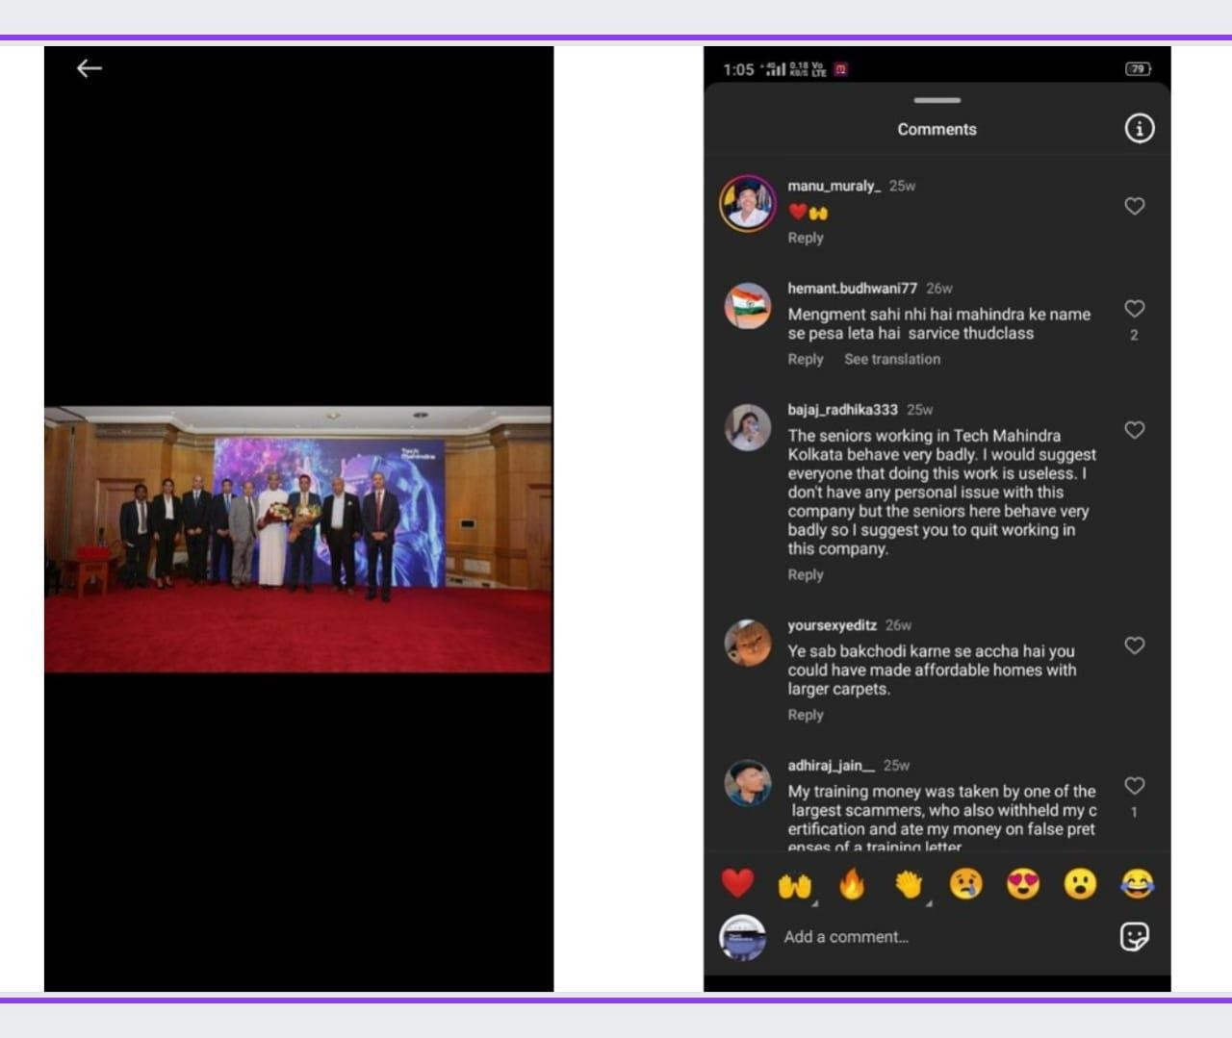
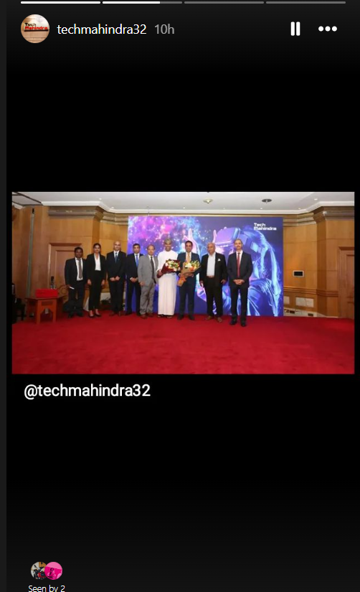
Instagram Story
Caption : Empowering Innovation, Transforming .
Hastags : #Tech Mahindra #Techm
Links : https://www.canva.com/design/DAGDfyQq Gps/V_JNAIlF7FhzVSHpWW_0gQ/view?utm
_content=DAGDfyQqGps&utm_campaign=de
signshare&utm_medium=link&utm_source= editor

Slide 40

Thank You
Presented by
Dunga Chandra Praveen Duvvi jayanth Lolla kalli Margana Naresh

